Slide 1
Click on the pictures that show the proper checkout procedures
If you’re right, you’ll see a smiley face. If you’re wrong, try again!
Start

Slide 2
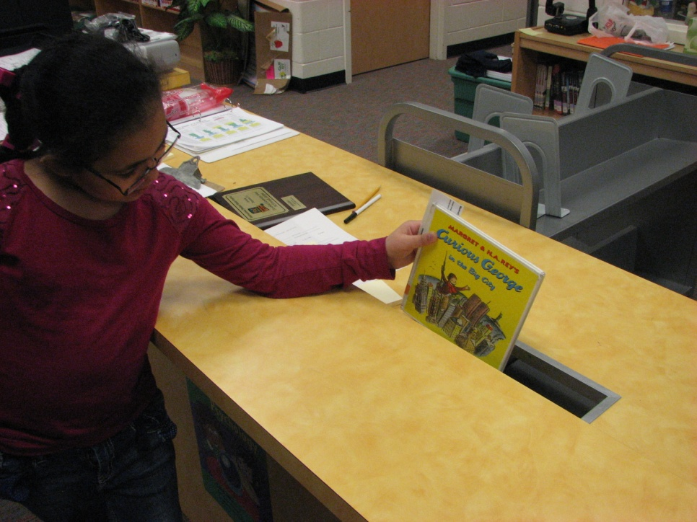
Which picture shows where to return a book when you’re finished?
Shelving Cart
Book Return

Slide 3
You’re CORRECT!
Yes! The book drop is where you return your book to when finished.
Next Question

Slide 4
Try again!
The shelf cart is where books are organized before being put back on the shelves. This is not where you give your book back.
Go Back

Slide 5
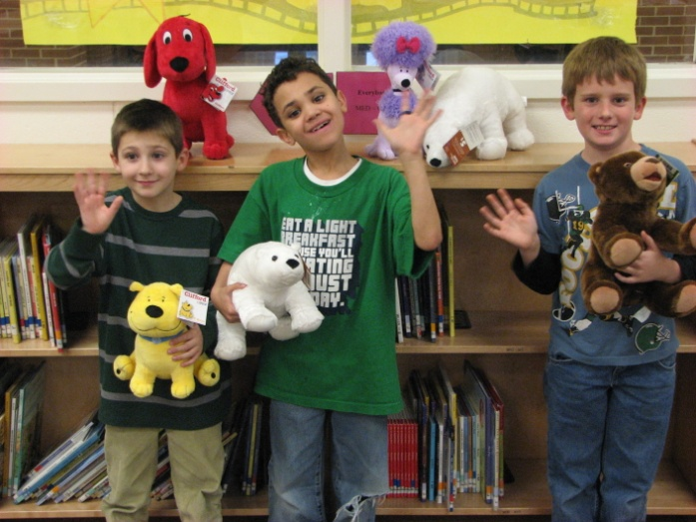
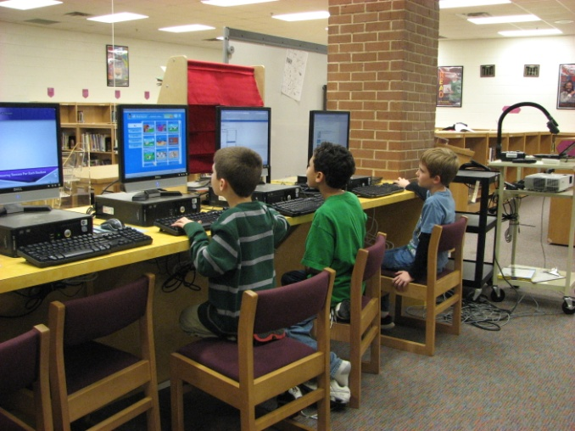
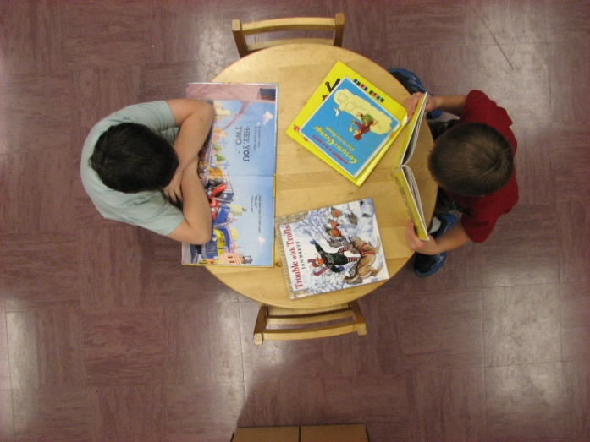
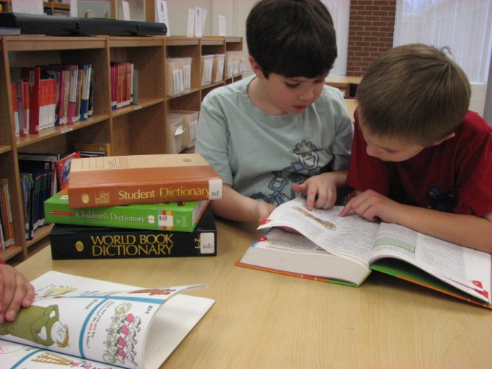
Which picture does NOT show what the media center is used for?
Playing
Learning
Reading
Research

Slide 6
You’re CORRECT!
Yes! You should not play in the media center. It is a place for learning and reading for fun.
Next Question

Slide 7
Try again!
That was one of the ways to correctly use the media center!
Go Back

Slide 8
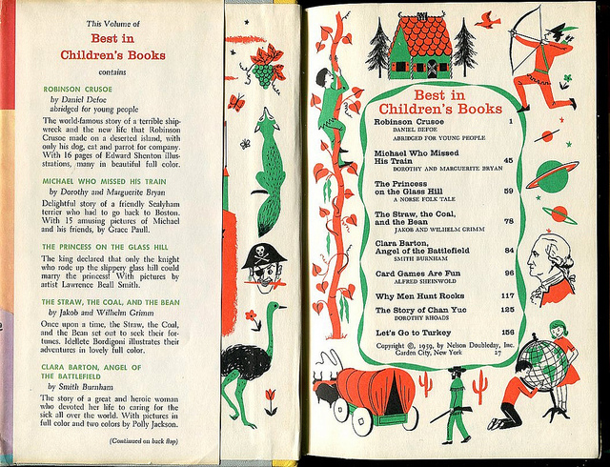
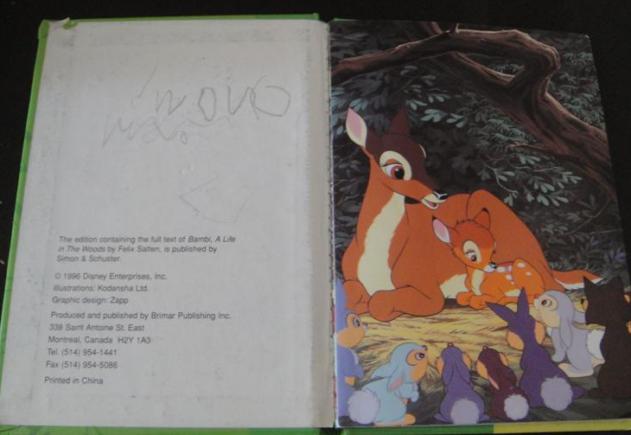
Which book is NOT damaged?

Slide 9
You’re CORRECT!
Yes! That was the book that was NOT damaged!
Next Question

Slide 10
Try again!
Sorry! That book was damaged!
Go Back

Slide 11
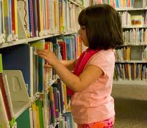
Who is searching the right way?

Slide 12
You’re CORRECT!
Yes! She was using a shelf marker to mark her place!
Next Question

Slide 13
Try again!
Sorry! Try again. Look at what she’s holding.
Go Back

Slide 14
Which book might be a just right book for this 5th grader?

Slide 15
You’re CORRECT!
Yes! That book was a JUST RIGHT FIT for her! It wasn’t too easy and it wasn’t too hard!
You’re finished with the practice exercise. Continue to Lesson 2 next.

Slide 16
Try again!
That was one was TOO EASY for her!
Go Back

Slide 17
Try again!
That one was TOO HARD for her!
Go Back

